Slide 1
Transgenerational Trauma- A model for understanding and how to heal
Dr Ciara Downes

Slide 2
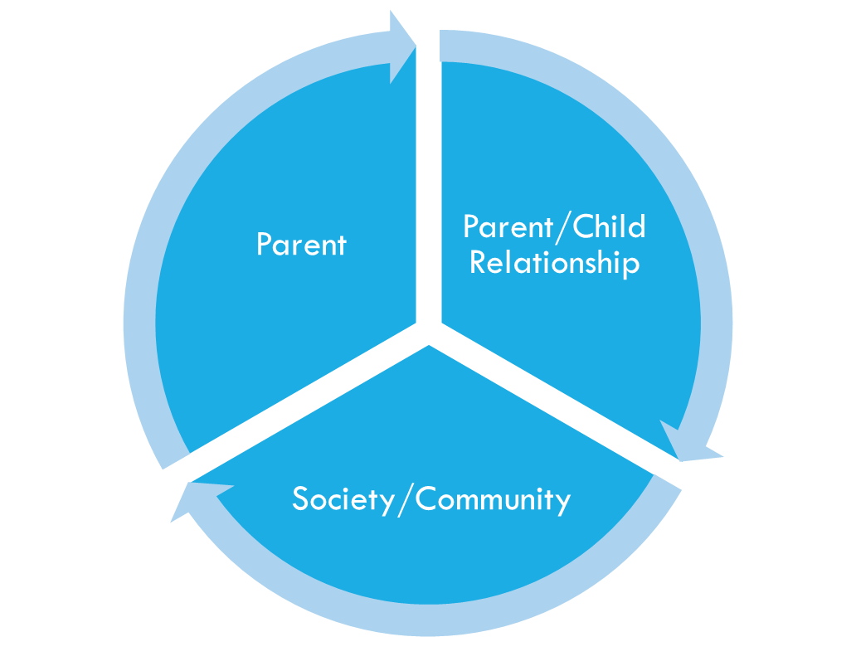
Transgenerational trauma Model

Slide 3
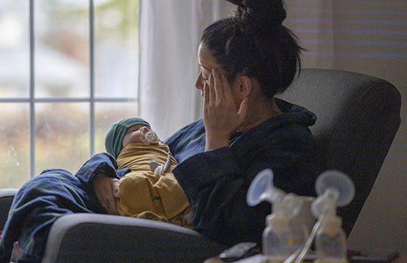
Transgenerational trauma model
Parent
Flashbacks, dissociation, nightmares
Trauma reminders
Trauma beliefs
Post-trauma adaptational styles

Slide 4
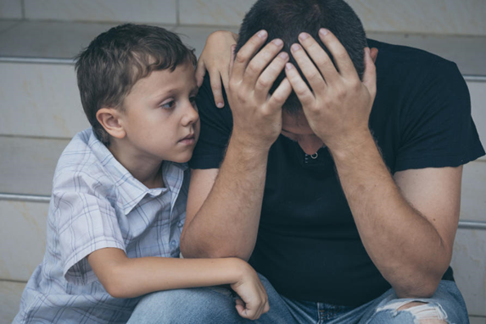
Transgenerational trauma model
Parent-child relationship
‘Conspiracy of Silence’
Parentified child/Acting out child
Bonding and Attachment
Lack of co-regulation

Slide 5
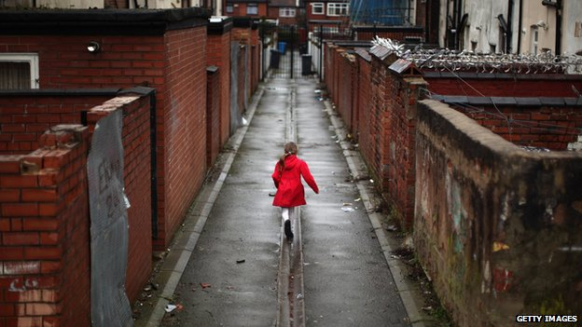
Transgenerational trauma model
Society and Communities
Poverty
Social Isolation
Educational/Work opportunities
Paramilitary control

Slide 6
transgenerational trauma cycle
Traumatised parent
Parents’ own trauma beliefs
Behavioural reactions in child
Parents’ trauma reactions are heightened
Child’s emotional and behavioural reactions
Parents’ post-trauma adaptational styles
Child’s trauma beliefs
Impact on parenting
Child becomes a parent
The cycle continues
‘I’m a bad person, I don’t trust others, bad things always happen’
‘I’m bad, I can’t rely on others, the world is unpredictable’
Victim
Numb
Fighter
Survivor
Context:
Poverty
Isolation
Lack of opportunities
Current threat
‘No-one understands me, I don’t understand me’
‘I want to protect you /you should be more grateful/I can’t cope’
‘The way my child is acting reminds me of the past’
‘I’m feeling emotions I don’t understand so I act out’

Slide 7
What helps? Society/Community
Positive educational/work/sport/arts opportunities
Education about the past, shared narratives
Prevent further trauma – recognising signs of abuse/neglect
Investment in Community/
voluntary/NHS trauma services
Addressing the past
Address poverty, social inequalities

Slide 11
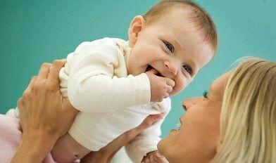
Because we’re coming to the end of that time..
Well hopefully we’ll see it you know.
When the Troubles will become history,
And history’s taught,
And it’s not lived.
(Quote by ‘Carol’ in Downes et al., 2012)

Slide 12
References
Danieli, Y., Engdahl, B.E. (2016) Multigenerational Legacies of Trauma: Modelling the what and how of transmission. American Journal of Orthopsychiatry, 14, pp. 1-13
Downes, C., Harrison, E., Curran, D., & Kavanagh, M. (2012) ‘The trauma still goes on...: the multigenerational legacy of Northern Ireland's conflict’, Clinical Child Psychology and Psychiatry, 18(4), pp. 583-603.
O’Neill, Siobhan, C. Armour, D. Bolton, B. Bunting, C. Corry, B. Devine, E. Ennis et al. (2015) "Towards a better future: the trans-generational impact of the Troubles on mental health." Belfast, Northern Ireland: Commission for Victims and Survivors.
Van IJzendoorn, M. H., Bakermans-Kranenburg, M. J., & Sagi-Schwartz, A. (2003). Are children of Holocaust survivors less well-adapted? A meta-analytic investigation of secondary traumatization. Journal of traumatic stress, 16(5), 459-469.

